Slide 1
Drought and Water Supply
Part 1. Drought Characterization and Simulation

Slide 2
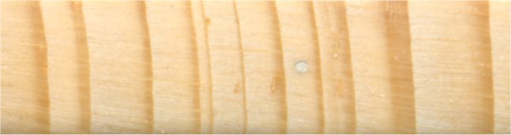
Across much of the western US, annual tree growth is limited by moisture availability
So:
– a dry year leads to a narrow growth ring
– a wet year leads to a wide growth ring
Douglas-fir, south-central CO
1977
1983
Notes:
Across the western US, with the exception of the wet coastal regions and the higher mountains, climates are generally arid or semi-arid, and so moisture is the main factor limiting tree growth. Thus, a dry year leads to a narrow growth ring, and a wet year leads to a wide growth ring.
Shown here is an image of annual tree rings from 1973-1984 from a Douglas-fir tree growing at about 8000’ in south-central Colorado. The range in ring widths reflects the annual moisture variability, with 1977 being an extremely dry year locally and across the region, and 1983 being an exceptionally wet year.
While it varies somewhat by tree species and the region of the West (the northern and northwestern parts of the western US are somewhat different), tree growth usually reflects the antecedent moisture from the fall, winter and spring prior to the summer growing season. Growth also responds to summer precipitation, but it is a less efficient source of moisture for the trees. In other words, the annual ring-width is typically an integrative measure of moisture over a roughly year-long period, corresponding closely to the October-September water year.

Slide 3
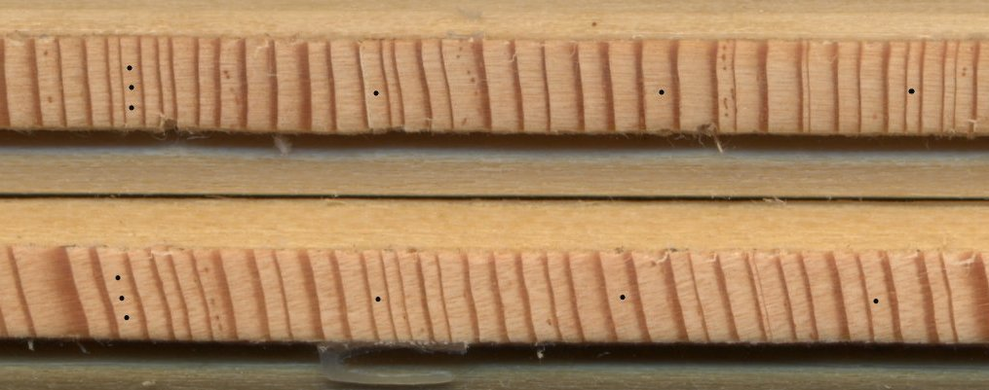
Crossdating the samples
Because of the common climate signal, the pattern of wide and narrow rings is highly replicated between trees at a site, and between nearby sites
This allows crossdating: the assignment of absolute dates to annual rings (not just ring-counting)
1900
1910
1920
1930
Two Douglas-fir trees south of Boulder, CO
When cored, the current year of growth is the first ring next to the bark
Notes:
There are three types of ring anomalies that would make a simple ring-count depart from the true annual sequence of growth:
Micro rings: In very unfavorable (dry) years, a tree may grow a very thin layer of new wood, and the resulting ring may be so small and difficult to see that it will be missed during a ring count.
Missing or absent rings: In the worst drought years, like 2002, no or virtually no growth will occur, and no annual ring will be seen in a core or cross-section. On the driest and most stressful sites, over 10% of the annual rings in any one tree may be absent, though a more typical figure is 1% to 4%. We will know these rings are missing because they will be present in trees that are growing in more favorable locations at that site.
False rings: If there is a very dry period in the middle of the summer growing season (as is typical in Arizona and New Mexico, prior to the monsoon), the tree may begin to shut down its growth processes and form the dark band of latewood which indicates the end of the growing season. Then when the rains return in late summer, the tree will resume “normal” growth, and then finally put on a true latewood band as fall approaches. So the tree forms what at first glance appears to be two annual rings.
By crossdating--comparing and matching the ring-width patterns among multiple trees, and multiple sites—we can identify these ring anomalies and ensure that each ring is assigned to the exact calendar year. This is critical if the tree-ring widths are to be calibrated with annual records of streamflow or climate.
For an online exercise to practice cross dating, see:
http://www.ltrr.arizona.edu/skeletonplot/introcrossdate.htm

Slide 4
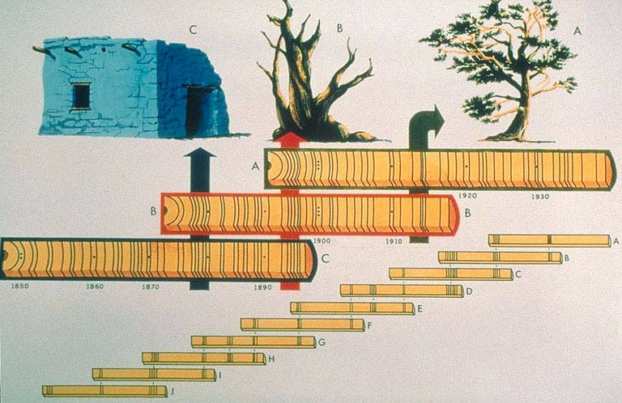
Crossdating allows the extension of tree-ring records back in time using living and dead wood
Image courtesy of LTRR (U. AZ)
Notes:
Crossdating also allows the dating of samples of dead wood (where the outside ring is not previously known) and incorporating those samples into the overall ring-width chronology from a site. In this way, tree-ring records can extend back much further than the maximum lifespans of living trees.
Here, wood from an archeological context is shown in “C” being used in the chronology. In practice, such wood is only used for reconstructing climate where it is locally abundant and there is a long history of occupation, mainly the Colorado Plateau, home of ancestral and modern Puebloans.
Dead wood in its original setting (as shown by “B”), in the form of upright snags, downed logs, and stumps, is used across the West in streamflow and climate reconstructions.

Slide 5
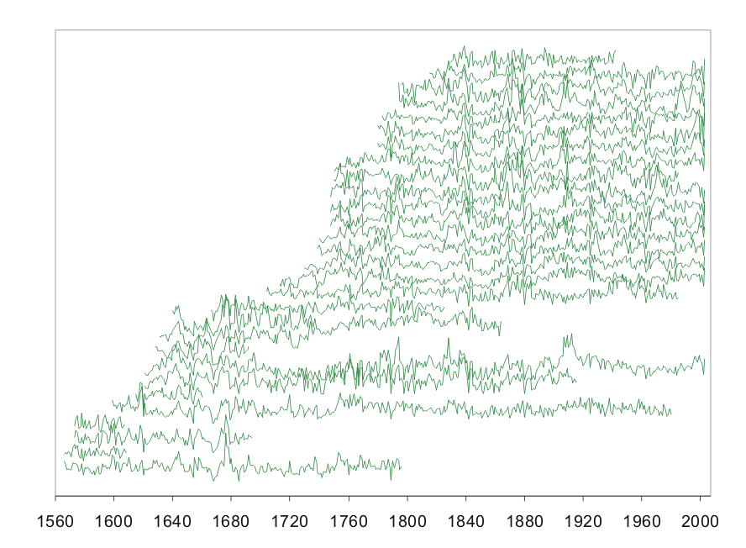
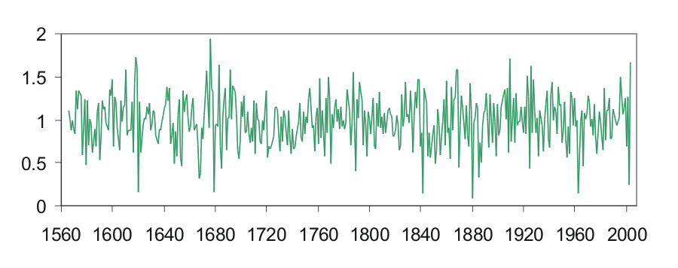
Compiling the ring-width series into the chronology
Van Bibber, CO (ponderosa)
30 series from 15 trees
Robust averaging
Ring width index
Notes:
Shown here schematically is the compilation of the ring-width series from all of the trees at one site into the site chronology. A software program called ARSTAN employs a robust biweight mean to average all of the ring-width values for each year, reducing the effect of outlying ring-width values.
You can see how the “peaks” and “valleys” in the ring-width series in the top graph are aligned in time, reflecting the common climatic influence on all the trees at the site. In the final chronology (bottom graph), these features are accentuated, reflecting the extraction of the climate signal by the compilation procedure.
As with the detrended ring-width series, the chronology is expressed in terms of ring-width indices, with a minimum of 0 and a mean of 1.
For more information about the ARSTAN program, see this page at the Lamont-Doherty Earth Observatory (Columbia U.) Tree-Ring Lab: http://www.ldeo.columbia.edu/res/fac/trl/public/publicSoftware.html

Slide 6
Palmer Drought Index (PDI)
Traditional Index of drought for past 60+ years
Cook et al., generated reconstructions of PDI for areas across US
Data used here is one of the longest records in the Dallas area, over 1000 years of reconstructed PDI
Gives an idea of climate for the past 1000 years

Slide 8
Period of Record

Slide 9
t₁
t₂
t₃
t₄
t₅
t₆
t₇
t₈
t₉
t₁₀
t₁₁
t₁₂
d₂
d₃
d₄
d₅
d₆
d₇
d₈
d₉
d₁₀
d₁₁
d₁₂
d₁
s₂
s₃
s₄
s₅
s₆
s₇
s₈
s₉
s₁₀
s₁₁
s₁₂
s₁
d_{i}: duration
s_{i}: severity
t_{i}: interarrival time

Slide 10
Code for Extracting the Droughts from the Palmer Index Reconstruction
Sub Find_droughts()
is_drought = False
numrecon = 1008
j = 0
ReconTally = 0
PrintMe = False
yearTally = 0
interarrival = 0
Dim recon As Range
Set recon = Worksheets("recon").Range("B3:B1010")
For i = 1 To numrecon
If recon(i) < 0 And Not is_drought Then
is_drought = True
j = j + 1
ReconTally = recon(i)
yearTally = 1
interarrivalTime = i - interarrival
interarrival = i
ElseIf recon(i) < 0 And is_drought Then
ReconTally = ReconTally + recon(i)
yearTally = yearTally + 1
ElseIf recon(i) >= 0 And is_drought Then
is_drought = False
DroughtArray(j) = ReconTally
yearArray(j) = yearTally
ReconTally = 0
PrintMe = True
End If
If PrintMe Then
Cells(j + 1, 4) = DroughtArray(j)
Cells(j + 1, 5) = yearArray(j)
Cells(j + 1, 6) = interarrivalTime
PrintMe = False
End If
Next i
End Sub
There are 196 Droughts in the 1000+ year record
Some are as long as 18 years (according to tree ring growth)

Slide 11
Drought Events
Start Year | End Year | Severity | Duration | Interarrival Time
998 | 1000 | -7.545 | 3 | 2
1003 | 1016 | -28.51 | 14 | 5
1020 | 1025 | -8.395 | 6 | 17
1028 | 1029 | -1.914 | 2 | 8
1032 | 1036 | -5.376 | 5 | 4
1038 | 1045 | -15.449 | 8 | 6
1047 | 1051 | -7.414 | 5 | 9
1057 | 1057 | -0.74 | 1 | 10
1061 | 1063 | -9.135 | 3 | 4
1066 | 1066 | -0.132 | 1 | 5
1069 | 1082 | -25.859 | 14 | 3
1085 | 1086 | -4.481 | 2 | 16
1089 | 1092 | -6.792 | 4 | 4
1099 | 1101 | -4.94 | 3 | 10
1103 | 1104 | -6.003 | 2 | 4
1107 | 1112 | -12.244 | 6 | 4
1115 | 1119 | -9.001 | 5 | 8
1121 | 1134 | -36.018 | 14 | 6
1137 | 1146 | -16.383 | 10 | 16
1148 | 1164 | -34.043 | 17 | 11
1167 | 1167 | -0.755 | 1 | 19
1181 | 1181 | -0.676 | 1 | 14

Slide 12
Procedure for Taking Drought Events and Creating a Bivariate Distribution
Create probability distributions for Duration and Severity. These are called marginal distributions
Use a specific bivariate distribution or copula which links the two marginal distributions

Slide 13
Marginal Distribution (Gamma) for Drought Severity

Slide 14
Marginal Distribution (Gamma) for Drought Duration

Slide 15



Multivariate Statistics
Since duration and severity are linked with drought , a probability distribution that combines them is required
Copulas are used to combine variables that are described individually as separate distributions

Slide 16
10-yr
25-yr
50-yr
100-yr
500-yr
1950’s Drought

Slide 17
Simulation

Slide 18
Drought and Water Supply
Part 2. Using the Drought Record to Anticipate Future Drought Events

Slide 20
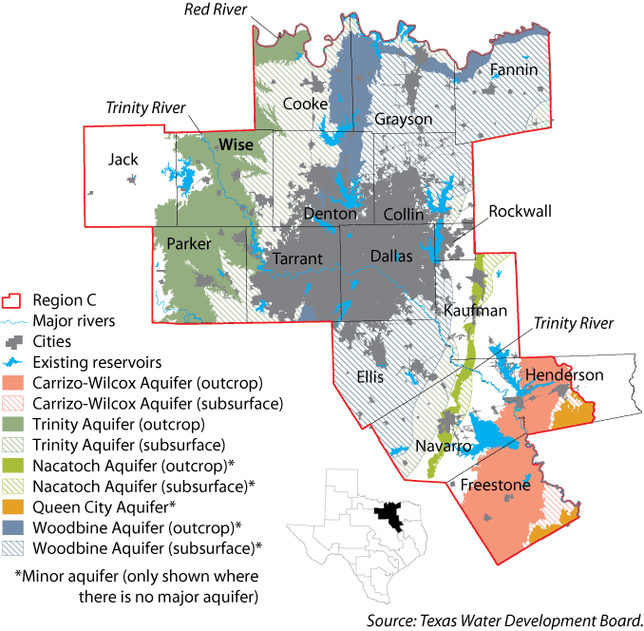
Lake Ray Roberts

Slide 21
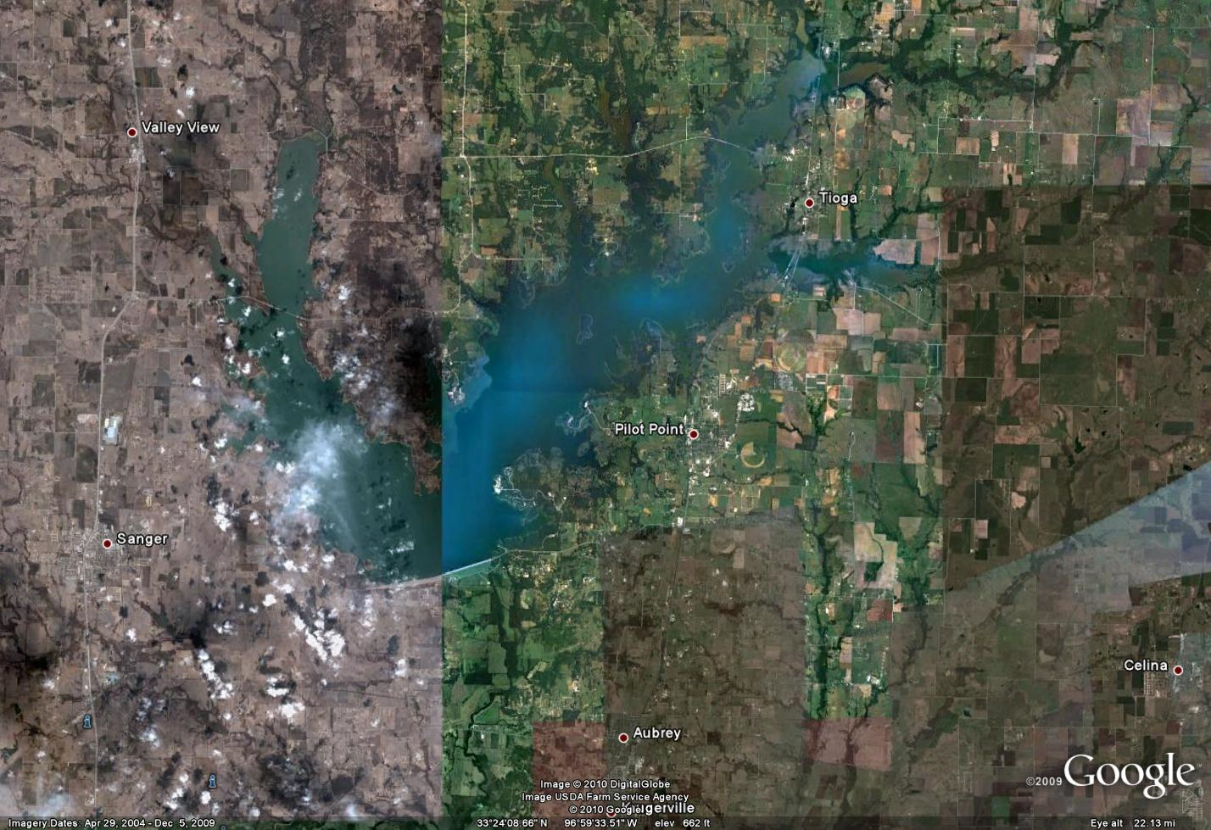
Lake Ray Roberts
Area = 30,000 acres
Storage Capacity = 800,000 acre-ft

Slide 22
Water Availability Modeling
TCEQ maintained models
Used to allocate water rights, based on Firm Yields
For .xls Model:
Historical Precipitation & Evaporation
Inflows based on naturalized stream flows
Elevation-Area-Capacity data

Slide 23
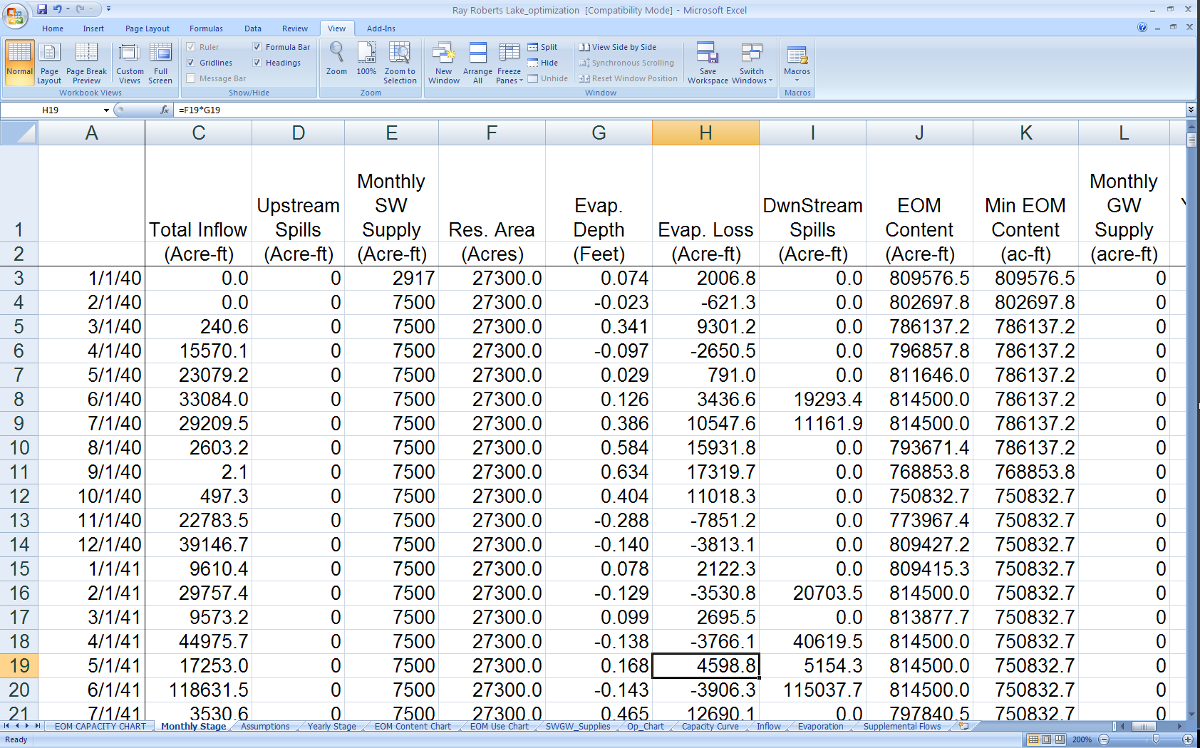
Using a Spreadsheet to Replicate WAM Firm Yield Calculations

Slide 24
Reservoir Performance During Period of Record
Firm Yield ~ 90,000 acre-ft/yr

Slide 25
Extending the Inflow and Net Evap data based on the PDI Reconstruction
Regressions were performed to generate both Inflow and Net Evaporation data for the years before Period of Record
The amount of supply was increased until the reservoir’s storage went to zero in the 1000 year simulation

Slide 26
Regression of Inflows

Slide 27
Regression of Net Evaporation

Slide 28
1000 –yr Reservoir Performance

Slide 29
Firm Yield?
Using Drought of Record – 90,000 acre-ft/yr
Using reconstructed drought record– 78,500 acre-ft/yr
87% of what we are currently expecting

Slide 30
Notes
The regressions are pretty poor
PDI may not be a good index
Might be better to perform a tree ring –stream flow/inflow reconstruction, taking out the PDI altogether
It would be fun to generate random droughts (re Monte Carlo) to test Reservoir Failure

Slide 31
Questions?

